Slide 1
Optical Character Recognition For Devanagari Font
Presented by:
Ashay Churi
Mayur Navarkar
Durgesh Waghmare
Guide:
Mr. Pankaj Sonawane

Slide 2
Introduction
OCR is used to recognize characters from the scanned digital image.
OCR can recognize both handwritten and printed text.
It converts scanned or printed documents to character that a computer can recognize.

Slide 3
Problem Definition
Currently there are many systems that are capable of performing OCR but all of those are build for formal international languages like English , Spanish , German etc. Therefore, we will implement a system that is capable of performing OCR for devanagari font.

Slide 4
Project Scope
We can make the computer read the handwritten documents.
No longer need to manually re-type important documents.
OCR is useful in various sectors like-
Banking
Legal
Healthcare

Slide 5
Literature Survey
Existing Systems for OCR :
OmniPage – First OCR program to run on pc.
ABBYY FineReader – Extended use of OCR in cell phones.
www.onlineocr.net - Online OCR from Image
www.pdfocr.net - Online OCR from PDF

Slide 6
Proposed System for OCR
- Offline OCR from the digital scanned image.
- Preprocessing of digital image for better
efficiency.
- Segmenting Image for ease of use.
- Recognition of Devanagari Script
Characters.
- Storing the recognized characters.

Slide 7
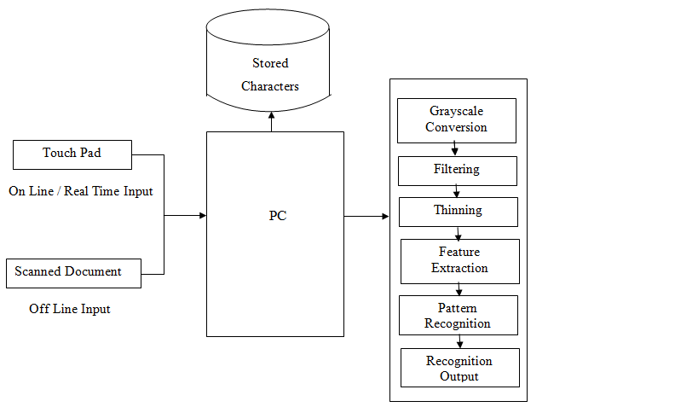
System Architecture

Slide 8
Implementation
Steps required for OCR :
Image Acquisition
Image Preprocessing
Image Segmentation
Feature Extraction
Recognize Characters

Slide 9
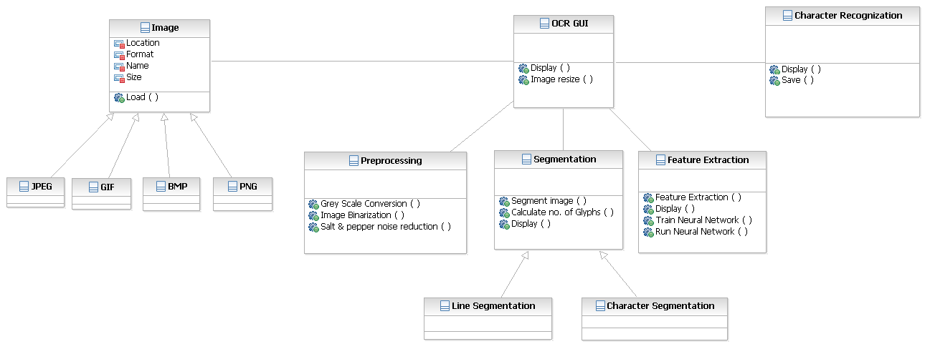
Class Diagram

Slide 10
Conclusion
We are going to build a system for a good OCR
approach which will eliminate the noise &
smooth the image for better recognition by
extracting the characters efficiently by training
the system.

Slide 11
References
Banashree N. P. and R. Vasanta, “OCR for Script Identification of Hindi (Devnagari) Numerals using Feature Sub Selection by Means of End-Point with Neuro-Memetic Model”- International Journal of Electrical and Computer Engineering 2007.
Christopher M. Bishop, “Text book on Neural Network for Pattern Recognition”.
Nazari , Jamshid & Ersoy – “Recognition of Handwritten Devnagari Characters through Segmentation and Artificial neural networks “- International Journal of Engineering Research & Technology (IJERT) Vol. 1 Issue 6, August - 2012 ISSN: 2278-0181.

